Slide 1
AUTOMATIC MATERIAL HANDLING EQUIPMENT
ASSEMBLY LINES

Slide 2
“We help our customers to enhance their production and
warehousing efficiency , saving thus money and time “

Slide 3
SUMMERY
1- SERVICE PACKAGE
2- SERVICE ITEMS
2.A- ELECTRONICS COMPONETNS ASSEMBLY LINE
2.B- COMPUTER PRODUCTS MANUFACTURING LINE
2.C- AUTO WAREHOUSE TRANSPORT SYSTEM
2.D- PRODUCT MATERIAL HANDLING SYSTEM
3- REAL CASES

Slide 4
1. SERVICE PAKAGE
AFTER SERVICE
PLANNING
DESIGN
MANUFACTURE
INSTALATION
COMPRENHENSIVE DIAGNOSIS AND EVALUATION
AD-HOC FOR THE CLIENT (TAILOR MADE)
STANDARDIZED AND MUDULIZED
FAST SETTING WITH ON-SITE FORMATION
24HS AVAILABLE
PLANNING -- Considering: Warehouse capacity, Material flow, Delivery process
DESIGN -- Maximizing the economic and production efficiency
MANUFACTURE -- Consistency and stability of the quality on the materials and product
INSTALATION -- Early pilot run with own trained crew to face any situation
AFTER SERVICE -- Provide consults and solution in the shortest time

Slide 5
2. SERVICE ITEMS
A- ELECTRONICS COMPONETNS ASSEMBLY LINE
(PCB Boards, PSU etc)
B- COMPUTER PRODUCTS MANUFACTURING LINE
(PC system, LCD Monitor/TV, NB etc)
C- AUTO WAREHOUSE TRANSPORT SYSTEM
(Circle/Pallet/ Box/ Board/ Type Auto Warehouse, Racks etc)
D- PRODUCT MATERIAL HANDLING SYSTEM
(Continuous Elevator, Pallet Lifter, Pallet Separator, Roller, Conveyor etc)

Slide 6
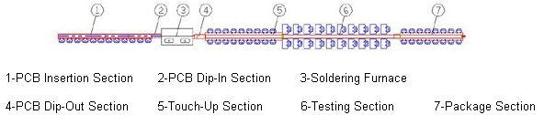
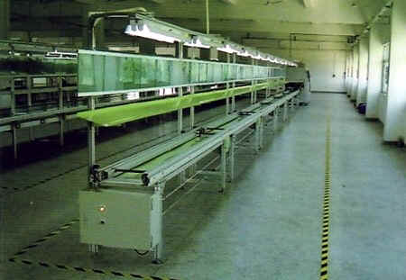
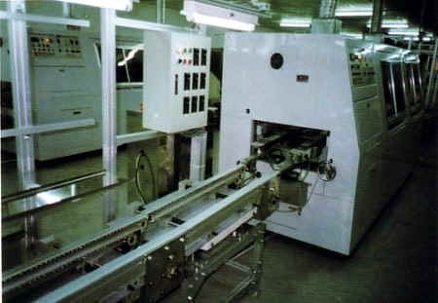
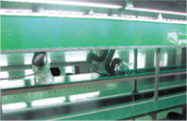
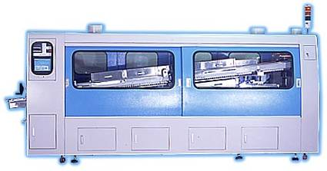
2.A- ELECTRONICS COMPONENTS ASSEMBLY LINE

Slide 7
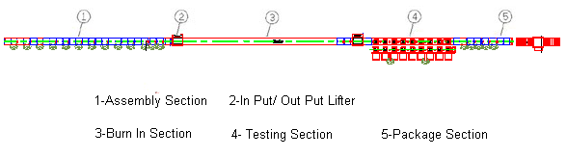
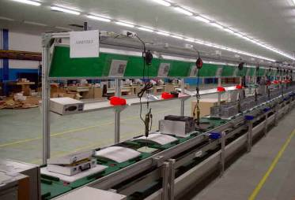
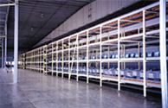
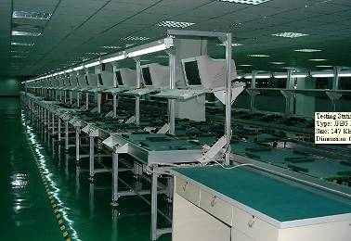
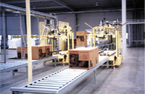
2.B- COMPUTER PRODUCTS MANUFACTURING LINE

Slide 8
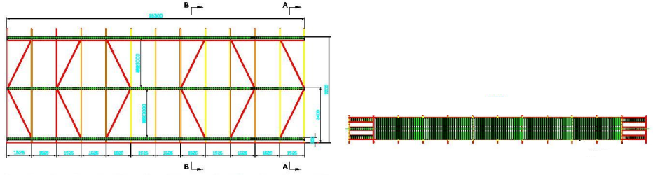
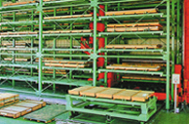
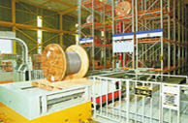
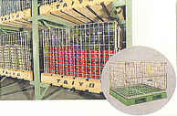
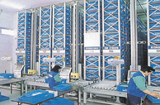
2.C- AUTO WAREHOUSE TRANSPORT SYSTEM

Slide 9
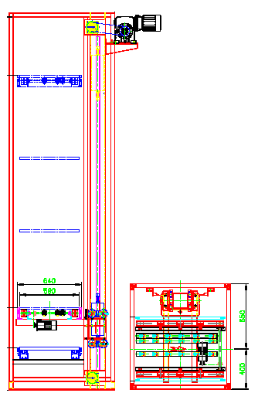
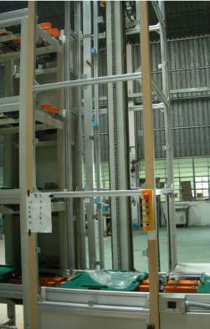
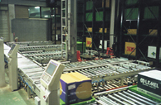
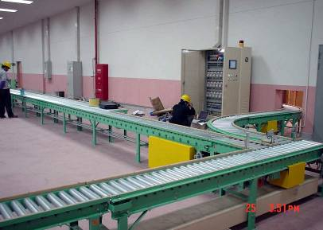
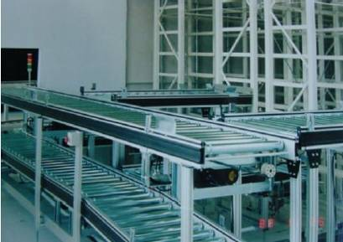
2.D- PRODUCT MATERIAL HANDLING SYSTEM

Slide 10
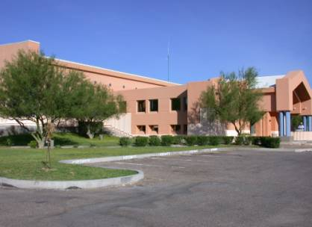
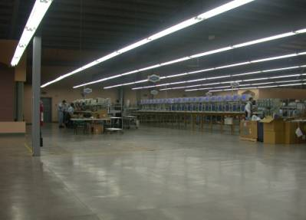
3. REAL CASES (MEXICO 2005)

Slide 11
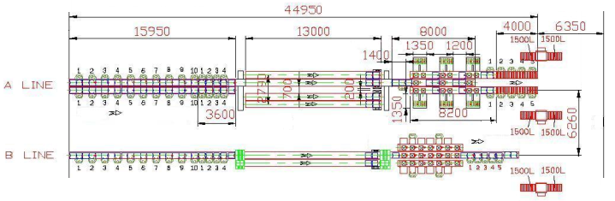
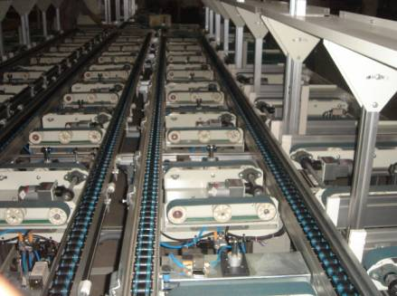
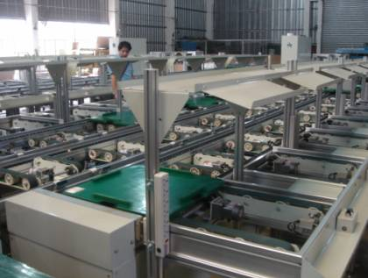
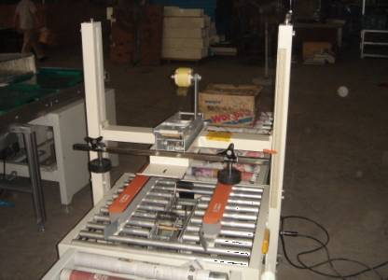
3. REAL CASES (MEXICO 2005)

Slide 12
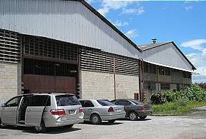
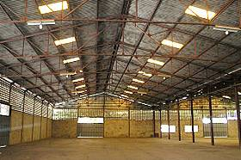
3. REAL CASES (VENEZUELA 2006)

Slide 13
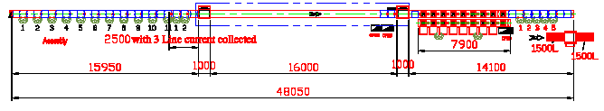
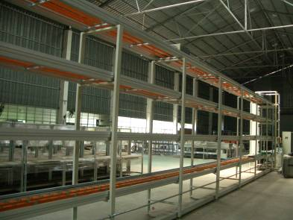
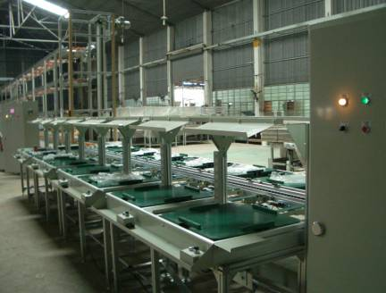
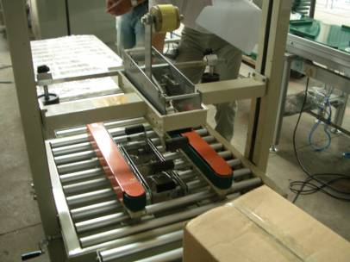
3. REAL CASES (VENEZUELA 2006)

Slide 14
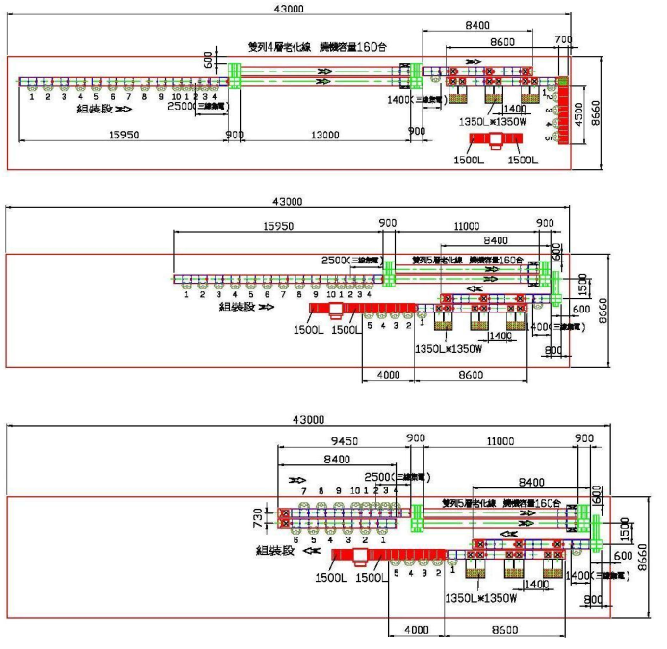
3. REAL CASES ( New Projects for 2007)

Slide 15
THANK YOU FOR YOUR ATTENTION

